Slide 1

GUIDE FOR BLIND
Smart Blind Stick Using Arduino and Ultrasonic Sensor

Slide 2

Team members:
Chollangi Prasanth (21BCE9339)
Mokara Hemanth kumar (21BCE9109)
Marudi Anjana devi (21BCE9061)
Allada Manasa (21BCE9087)
Neeli Subhash (21BCE9549)
Bylapudi Lahari (21BCE9969)
Guided by:
Prof: Phani kumar meduri

Slide 3

INTRODUCTION:
AIM:
The study focuses on utilizing an ultrasonic sensor with a maximum range of 2 meters to detect obstacles and changes in terrain, such as holes or stairs, aiming to aid blind individuals in navigating their surroundings more effectively.
This ultrasonic blind stick have a several feature that surely can help this blind people to navigate routes and detect an obstacle that surely can make their life routines easier.
The user just need to use the blind the normal blind stick , the different is , blind people can detect a hole or stair more faster and easily.
To create sensor-based stick for real-time blind navigation and obstacle detection.

Slide 4

OUR AGENDA IS…
This project intends to make ease for the optically defected people as a guide.
To make them feel confident enough to do their works on their own.
To help them to be aware of their surroundings as equally as a normal person.
To make them feel safe and secure to move around while walking
Keywords: Arduino uno, Ultrasonic sensors, RF transmitter and receiver

Slide 5

HOW DOES IT WORK…?
The Smart Blind Stick scans the path in front of it with the help of an HC SR04 Ultrasonic sensor.
Whenever the sensor detects any object in its path the buzzer starts beeping and also at the same time the LED turns on.
The blind person can hear the beeping of the buzzer and manage to change the way. In this way, the person can easily find his way without getting injured.
This smart stick works in the same way as the Ultrasonic range finder did. You can also see the real-time values of the distance in cm on the Arduino serial monitor.

Slide 6

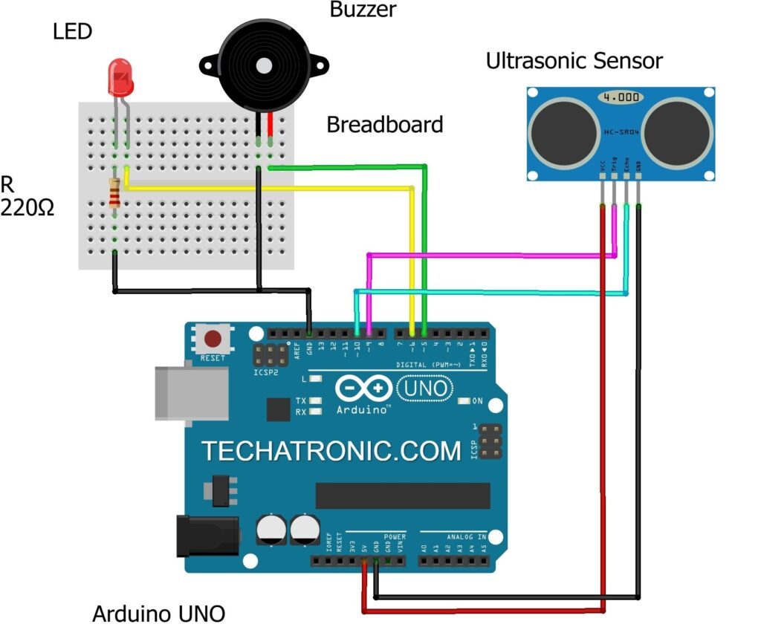
CIRCUIT DIAGRAM

Slide 7
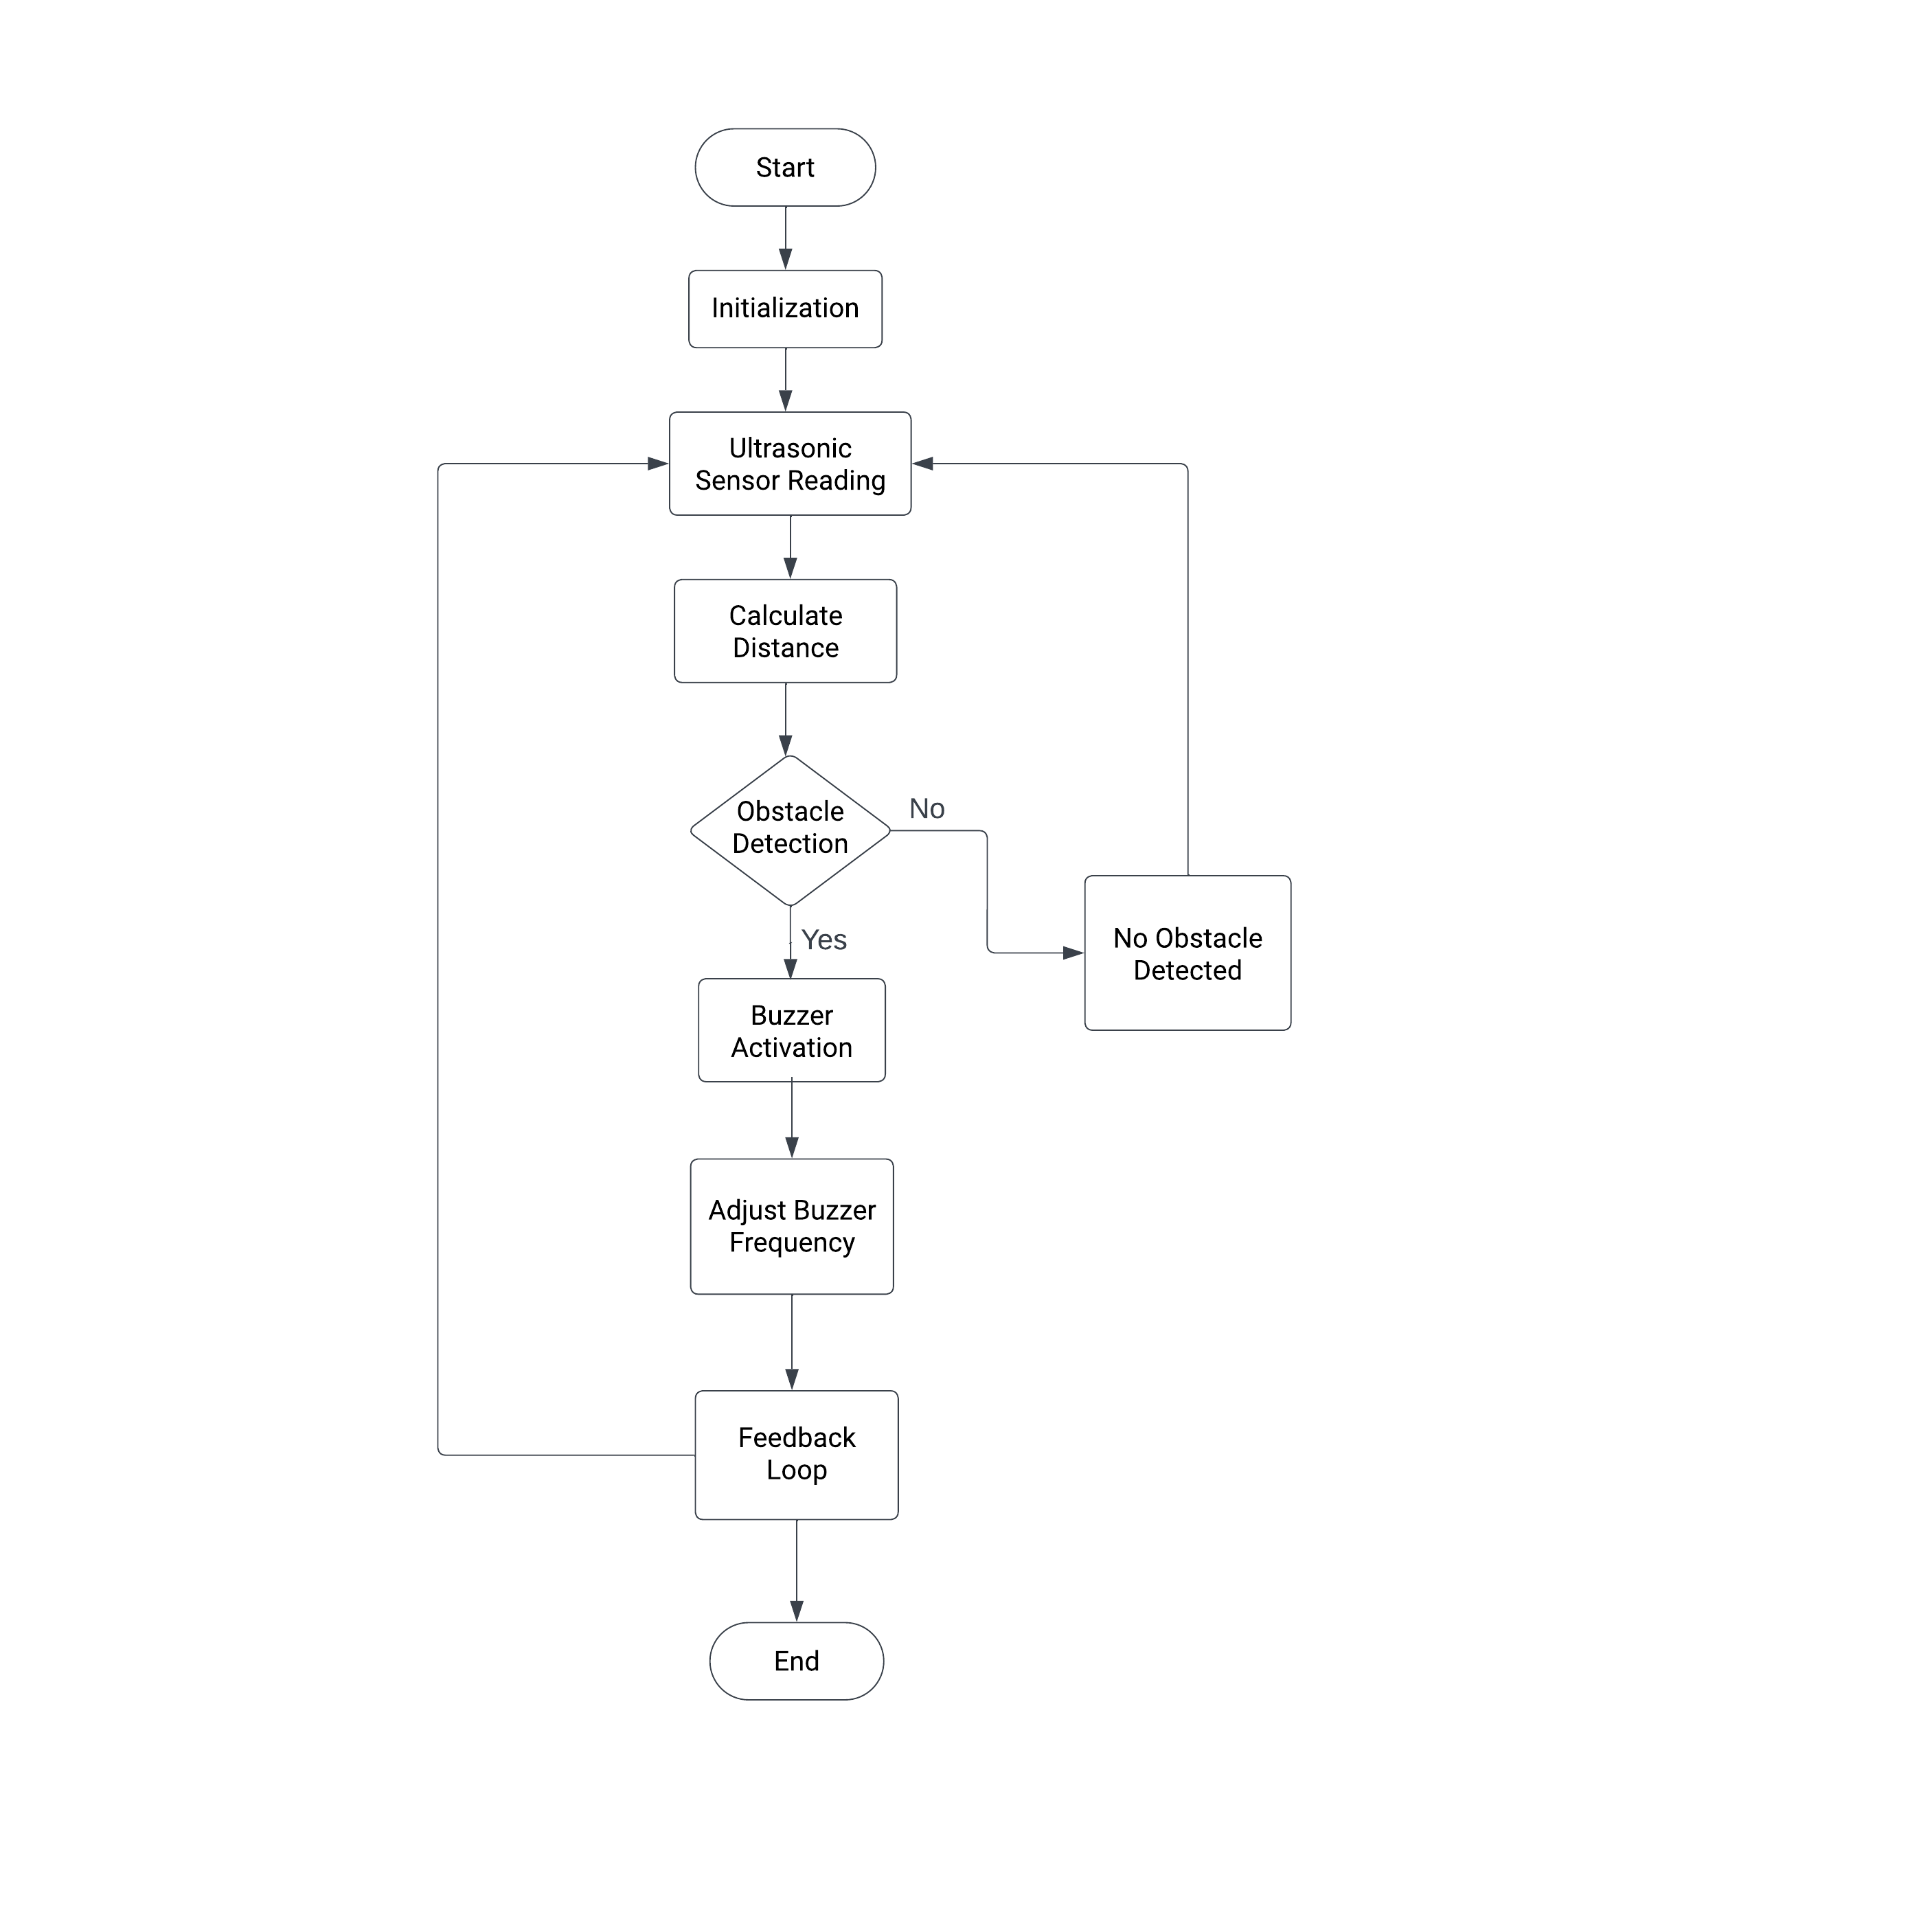
FLOW CHART:

Slide 8
WORKING MODEL
Project Objective: Aid visually impaired individuals in walking comfortably while receiving obstacle warnings through a frequency-changing buzzer signal.
Warning System: Buzzer frequency increases as objects get closer, providing proximity feedback.
Key Component: Utilize the Ultrasonic Sensor HC-SR04.
Sensor Function: Emit high-frequency sound pulse, calculate echo time, and interpret the reflected signal for distance measurement.
- Calibration: Calibrate sensor based on the speed of sound (341 meters per second) to determine distance from time-delay calculations.

Slide 9
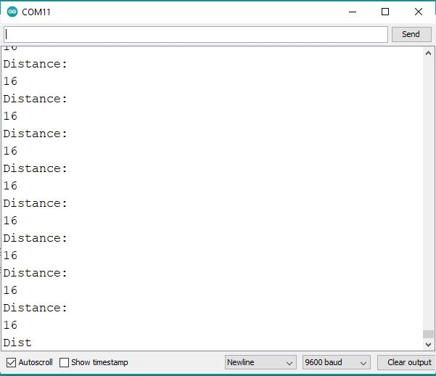
MODULE IMPLEMENTATION
Code:
OUTPUT:
const int trigPin = 9;
const int echoPin = 10;
long duration;
int distanceCm, distanceInch;
void setup()
{Serial.begin(9600);
pinMode(trigPin, OUTPUT);
pinMode(echoPin, INPUT);
pinMode(6, OUTPUT); // Connect LED Pin D6
pinMode(5, OUTPUT); // Connect Buzzer Pin D5
}
void loop()
{
digitalWrite(trigPin, LOW);
delayMicroseconds(2);
digitalWrite(trigPin, HIGH);
delayMicroseconds(10);
digitalWrite(trigPin, LOW);
duration = pulseIn(echoPin, HIGH);
distanceCm= duration*0.034/2;
distanceInch = duration*0.0133/2;
Serial.println("Distance: ");
Serial.println(distanceCm);
delay (100);
// See the Ultrasonic Sensor Value in Serial Monitor
if(distanceCm < 25) // You can Change the value
{ digitalWrite(5, HIGH); // Buzzer ON
digitalWrite(6, HIGH); // LED ON
}
else
{ digitalWrite(5,LOW); // Buzzer OFF
digitalWrite(6,LOW); // LED OFF
}
}

Slide 10
FUTURE IMPLEMENTATION
In future, we will be modifying the proposed model in better way. Initiating with the addition of Bluetooth module for proper on and off functioning.
Integration of GPS module for detecting location of user, in case of an emergency.
GPS module will be integrated in combination of Bluetooth Module of Arduino UNO connecting it to the mobile phone for better and smooth location detection.
Besides, soil moisture detector can be implemented for detecting the amount of moisture in the soil, providing the safer access of the path to the user.
We can detect pit holes Infront of blind person

Slide 11
REFERENCES
https://maxbotix.com/blogs/blog/how-ultrasonic-sensors-work#:~:text=An%20ultrasonic%20sensor%20is%20an,information%20about%20an%20object's%20proximity.
https://www.arduino.cc/
https://techatronic.com/smart-blind-stick-using-arduino-and-ultrasonic-sensor/

Slide 12
THANK YOU

